Slide 1
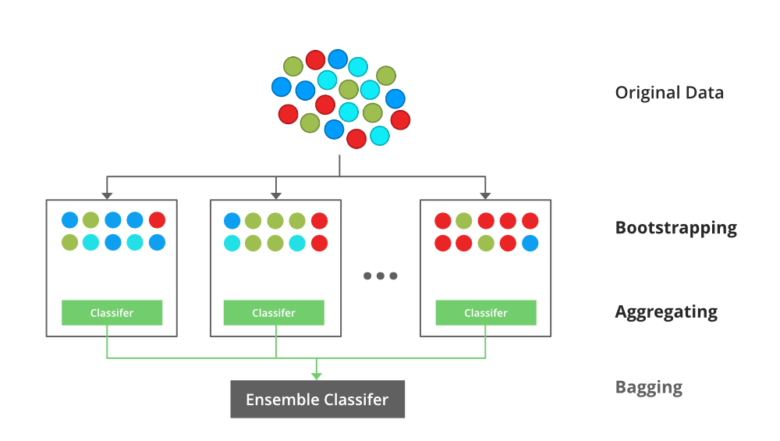
XG BOOSTING
XGBoost is a popular and efficient open-source implementation of the gradient boosted trees algorithm.
Gradient boosting is a supervised learning algorithm, which attempts to accurately predict a target variable by combining the estimates of a set of simpler, weaker models.

Slide 2
XG BOOSTING
XGBoost stands for “Extreme Gradient Boosting” and it has become one of the most popular and widely used machine learning algorithms due to its ability to handle large datasets and its ability to achieve state-of-the-art performance in many machine learning tasks such as classification and regression.
XG Boosting Parameters:
General Parameters: Guide the overall functioning
Booster Parameters: Guide the individual booster (tree/regression) at each step
Learning Task Parameters: Guide the optimization performed

Slide 3
XG Boosting Hyper Parameter
1.General Parameters
1.booster [default=gbtree]
2.silent [default=0]
3.nthread [default to the maximum number of threads available if not set]
2.Booster Parameters
1.eta [default=0.3]
2. min_child_weight [default=1
3. max_depth [default=6]
4. max_leaf_nodes
5. gamma [default=0]
6. max_delta_step [default=0]

Slide 4
XG Boosting Hyper Parameter
3.Learning Task Parameters
1.objective [default=reg:linear]
2.eval_metric [ default according to objective ]
rmse – root mean square error
mae – mean absolute error
logloss – negative log-likelihood
error – Binary classification error rate (0.5 thresholds)
merror – Multiclass classification error rate
mlogloss – Multiclass logloss
auc: Area under the curve
3. seed [default=0]

